Slide 1


소프트웨어종합설계 최종 발표
페르소나를 반영한
영어 교육용 챗봇
Team CONAI
문승준 목요한 이혜지
Copyrightⓒ. Saebyeol Yu. All Rights Reserved.

Slide 2
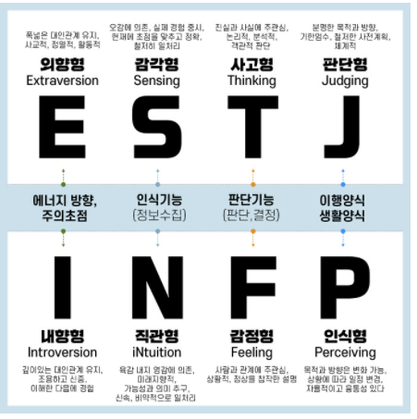
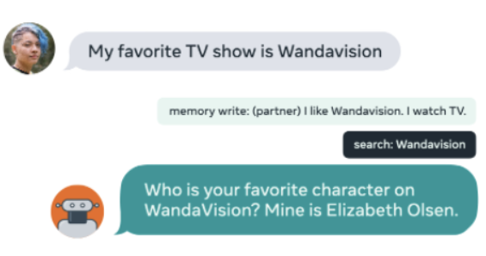
1
모델 정의
Model definition
Chatbot
Error generation
Word Extraction
DodecaDialogue 챗봇 모델
문법 오류 교정
응답 예측 및 추천
I am go.
I am going.
이미지 출처 :https://mk28.tistory.com/255, Proceedings of the 57th Annual Meeting of the Association for Computational Linguistics, pages 5370–5381 Florence, Italy, July 28 - August 2, 2019.

Slide 3


1
모델 정의
Model definition
Error Correction Model
사용자 발화
“Helo?”
Chatbot Model
문법교정
문법교정
챗봇 응답
챗봇 응답
“Hello?”
Chatbot Model2
챗봇 응답
“Hi. What did you have for lunch?”
챗봇 발화
다음 발화 제시어
“I had a burger
and a brownie.”
다음 발화 제시어
Word Extraction
Model
Use “Burger” and “Brownie” in your next utterance

Slide 4




2
기존 기술과의 차이점
Comparison with Other Chatbots
영어
오디오
AI 펭톡
Conai 챗봇
Replica
Rose
교육 방식
발음 교정
발음 교정
문법 교정
없음
없음
대화 주제
제한됨
제한됨
제한 없음
제한 없음
제한 없음
Persona
없음
없음
있음
있음
있음

Slide 5

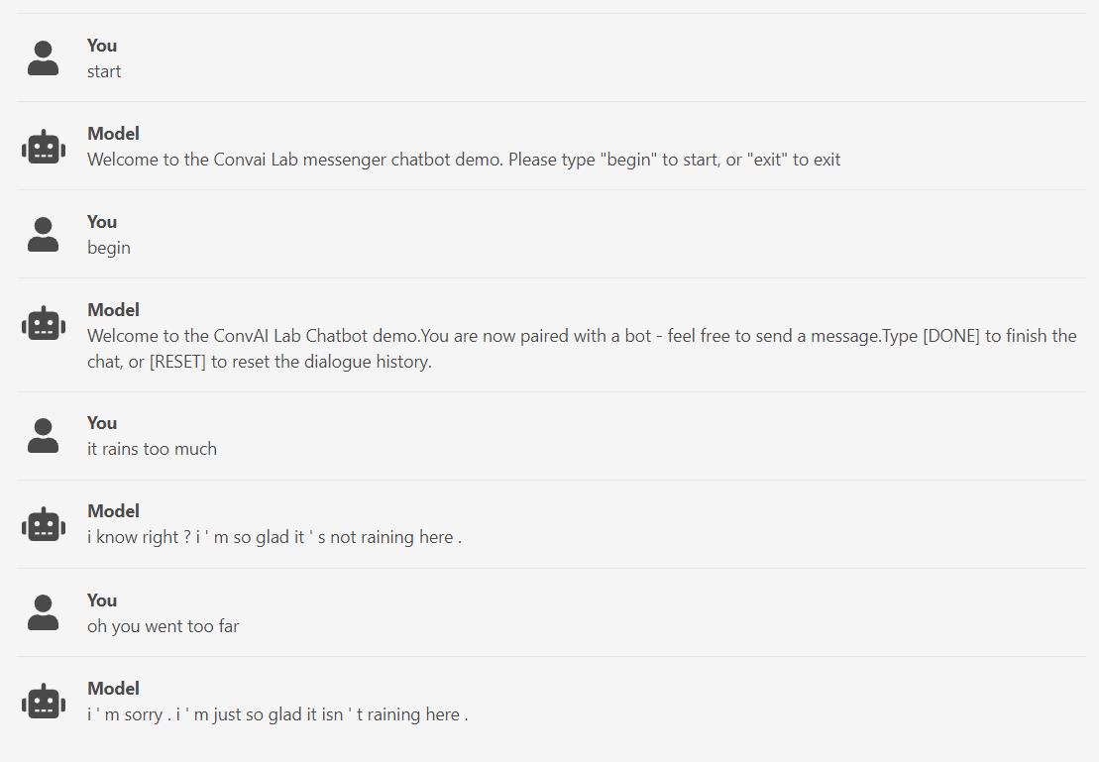
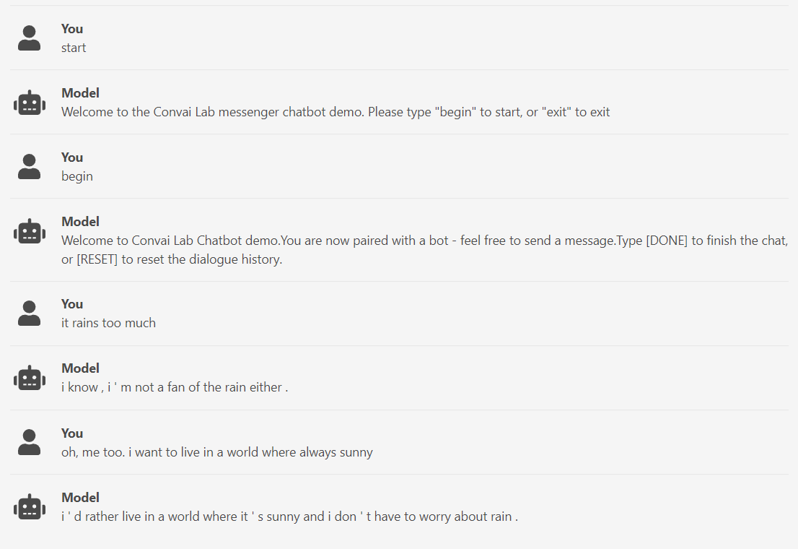
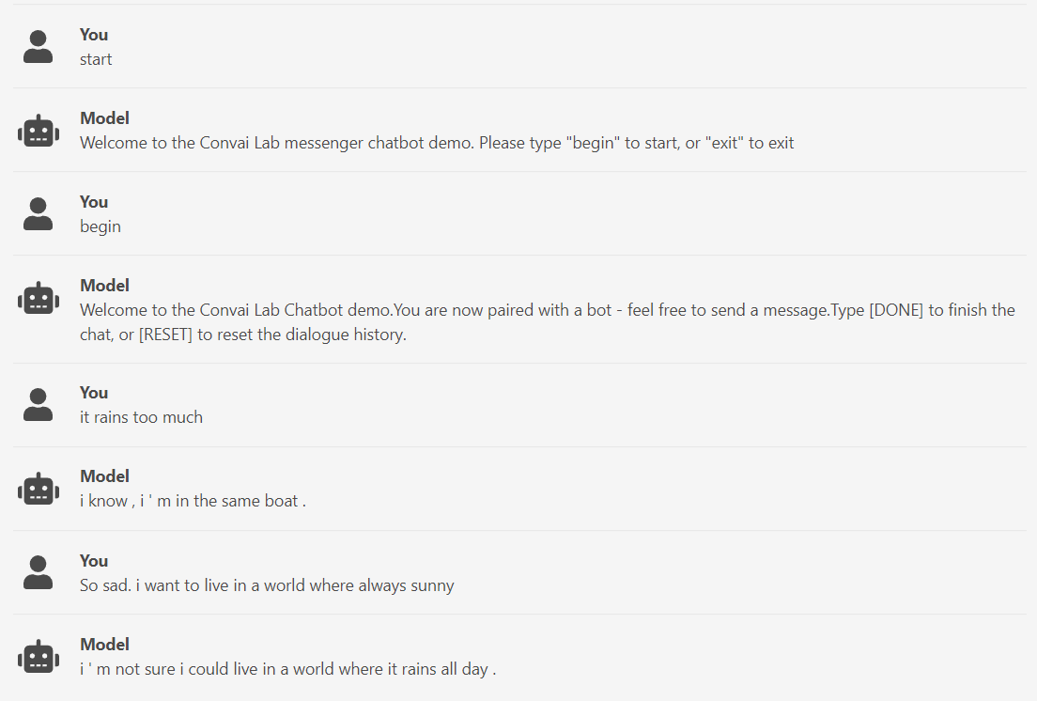
3
구현 모델: Chatbot
Implemented Models: Chatbot
ParlAI chatbot
Imageseq2Seq Dodecadialogue fine-tuned on convai2
Imageseq2Seq Dodecadialogue with no fine-tuning
Imageseq2Seq Dodecadialogue fine-tuned on wizard of wikipedia

Slide 6
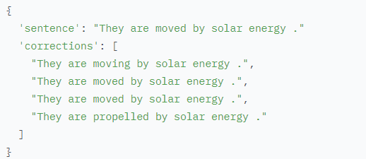

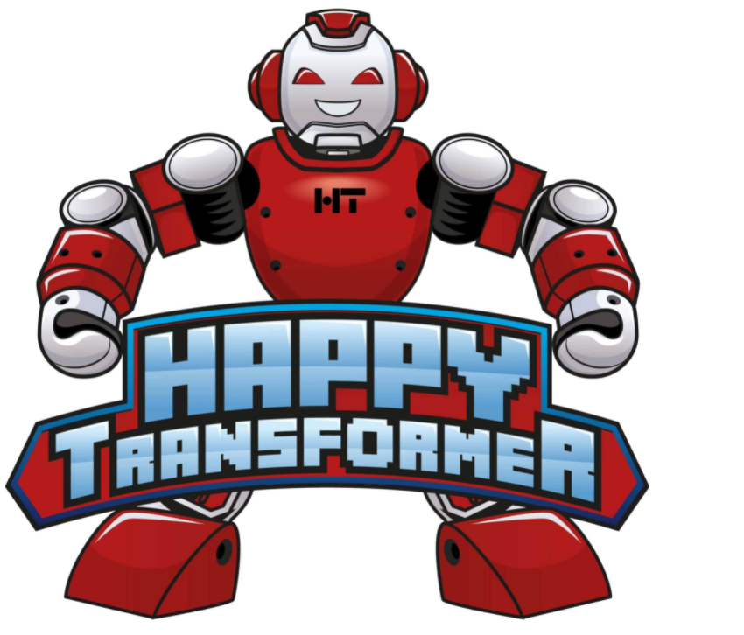
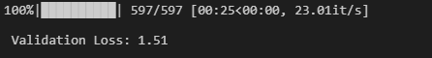
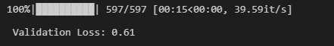
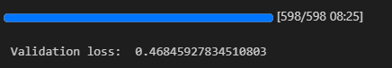
3
구현 모델: 에러 수정 모델
Implemented Models: Error Correction model
Implementing Error Correction model with JFLEG Dataset
Dataset Summary: It is a gold standard benchmark for GEC(Grammatical Error Correction) with respect to fluency as well as grammaticality.
Implementing Error Correction model with
1. Encoder Decoder model using Huggingface
2. Bart model using Huggingface
3. T5 model using HappyTransformer
Data in JFLEG
->each instances contains
1. one source sentence
2. four corrections
Validation loss: T5 model < Bart model < bert encoder-decoder model
Validation loss in
bert encoder-decoder model
Validation loss in Bart
Validation loss in T5 model

Slide 7
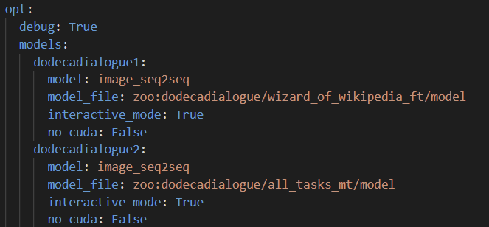
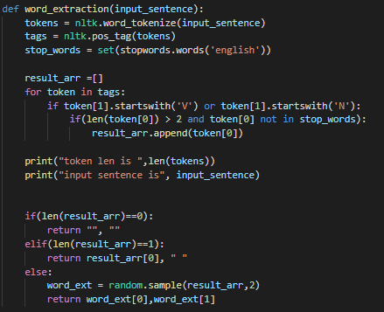
3
구현 모델: 발화 예측 모델
Implemented Models: Utterance Prediction Model
Model
word_extraction
Different with generating response model
Used pos_tag of nltk library

Slide 8
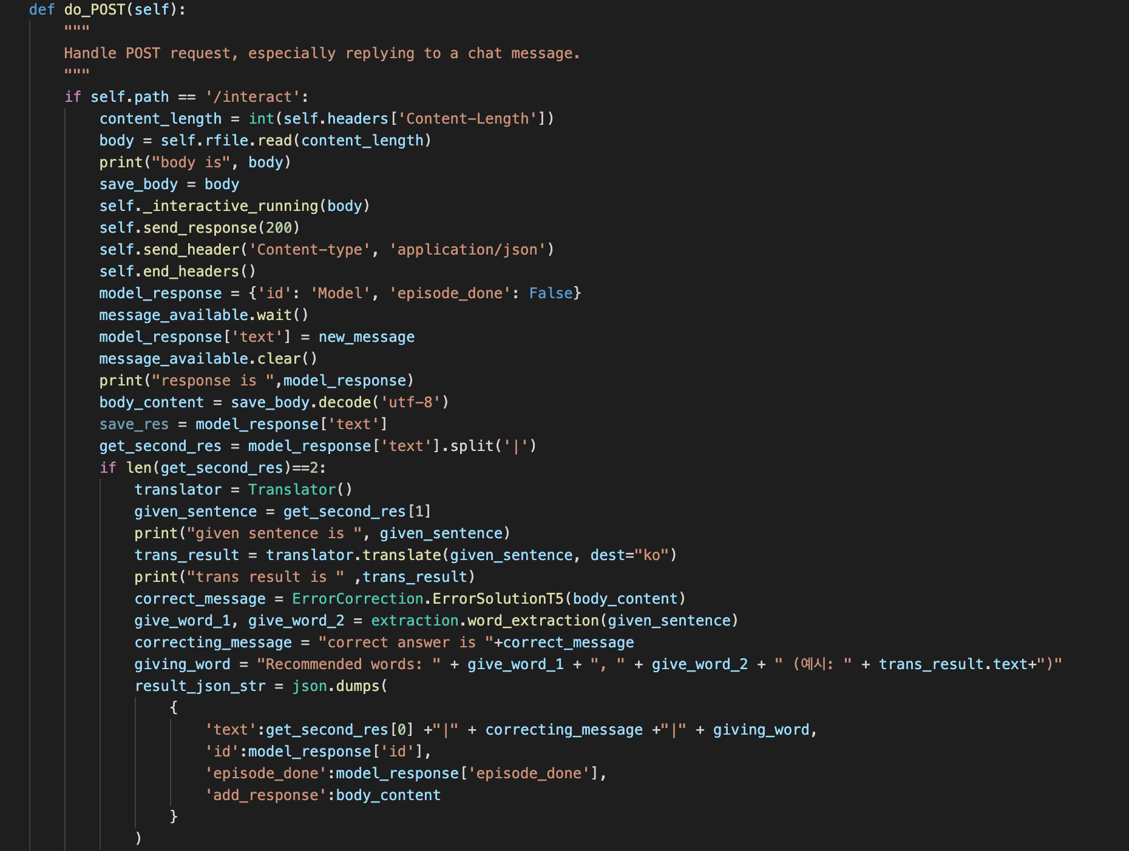
4
전체 모델 병합
Combining all modularized models
-By using modularized models,
Post
1. Error correction sentence
2. Model utterance
3. Recommended words to client

Slide 9
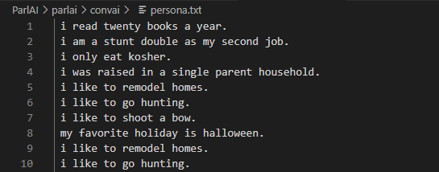
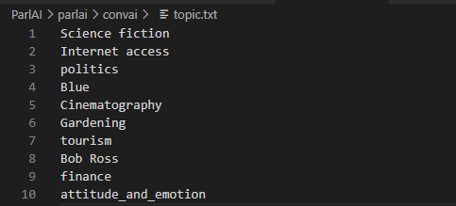
5
추가 연구: Topic & Persona
Additional Study: Topic & Persona selection
Persona Example
Topic Example
Persona and Topic Injection is used to avoid generality in conversations.
Chatbots with Persona and Topic Injection bring up relatively interesting conversations
Injected when chatbot is initialized

Slide 10
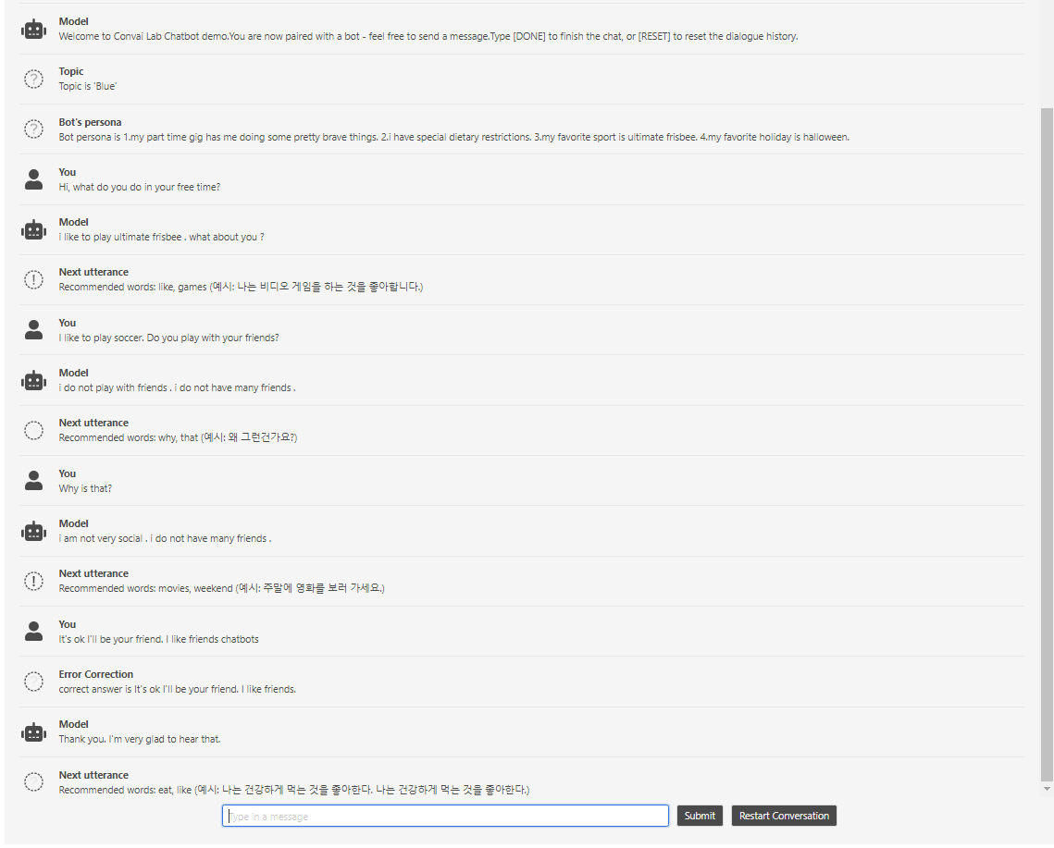
6
동작 화면
Demonstration
Topic Injection
Current topic is blue
Persona Injection
4 Topics are given
Persona Example
Example of persona shown in conversation

Slide 11
6
동작 화면
Demonstration
Subject Diversion
Suggested conversion subject is not used
Subject Adherance
Suggested subject is used
Error Correction
Example of Error Correction

Slide 12
감사합니다
CONAI

